Slide 1

Chapter 4
Building Agent-Based Models with NetLogo
Notes:
This chapter provides an overview of the programming language and concepts that are used within NetLogo. NetLogo basics, such as how to create a simple environment, commands and procedures, are presented with step by step instructions for creating a simple model. Following this basic model, more advanced features are introduced. The overall aim of this chapter is to provide an understanding of the main components that make a NetLogo program. Subsequent chapters build upon the basics presented here.

Slide 2
Learning Objectives
By the end of this chapter, students will be able to:
Identify some of the tools that are commonly used to do agent-based modelling
Use NetLogo to run agent-based models
Understand the meaning of the most common NetLogo commands and how the program has been organised

Slide 3
Overview
An overview of tools for agent-based modelling
An introduction to NetLogo:
The Program itself
Turtles and Patches
Variables
Flow Control
How to write good code

Slide 4
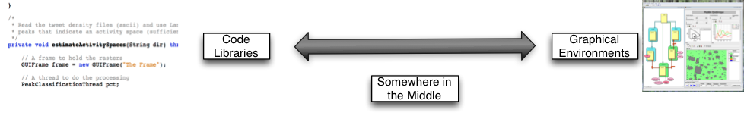
Software Tools / Platforms
What are they?
Pieces of software to help people build models
There is a wide range of tools available:
Computer code ('libraries')
Entire graphical environment
Somewhere in the middle

Slide 5
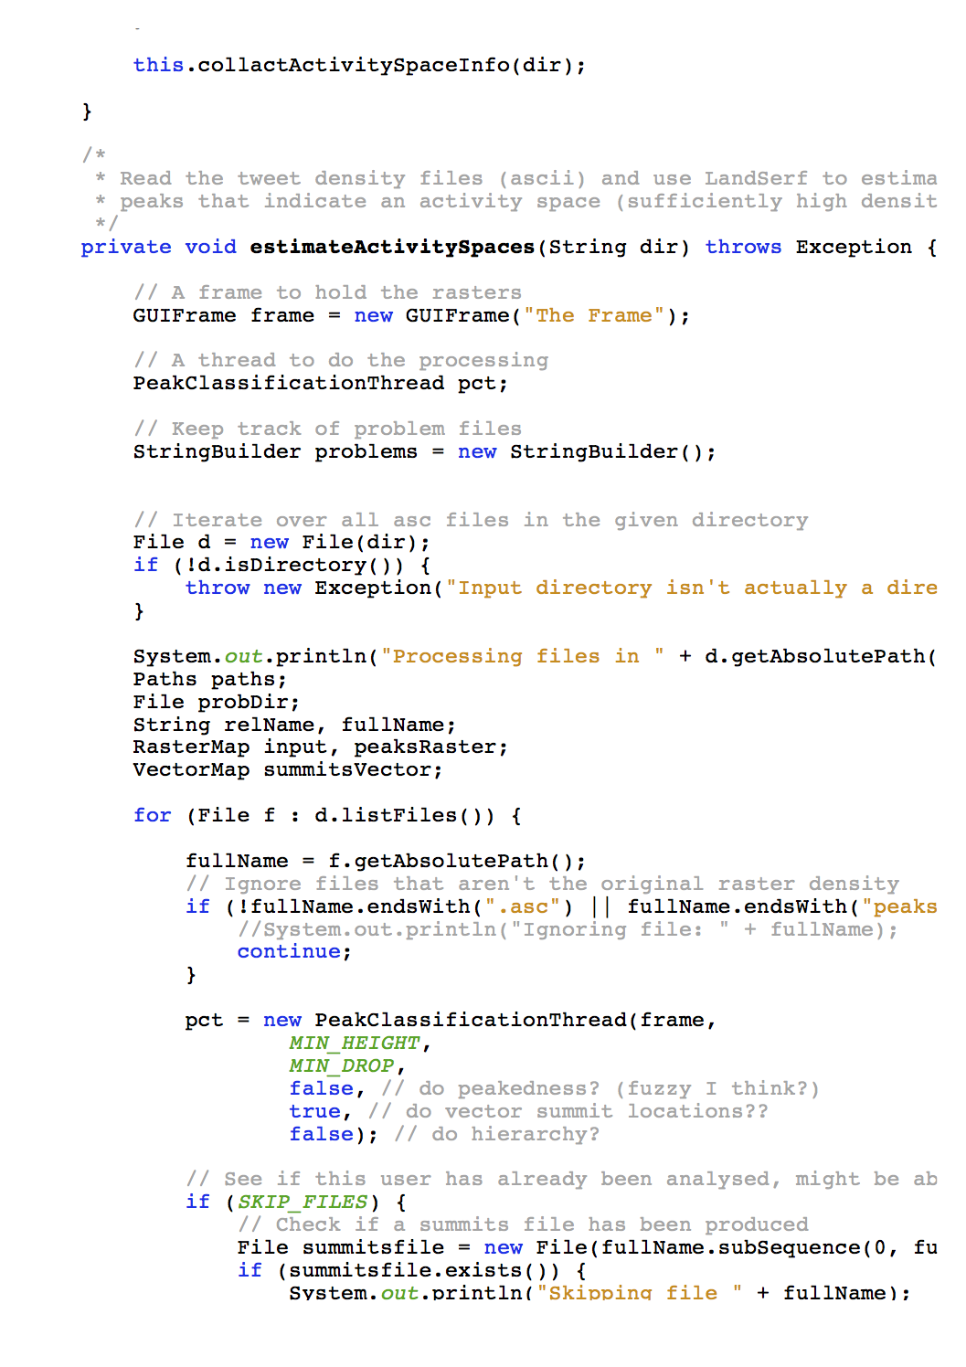
Computer code (‘libraries’)
Researchers write software to perform useful functions:
Draw graphs
Visualise the model
Manage the schedule
Great for programmers
Less time spend worrying about admin, more time on modelling
Examples:
MASON
Repast Simphony
Mageo
Loads of others listed here

Slide 6
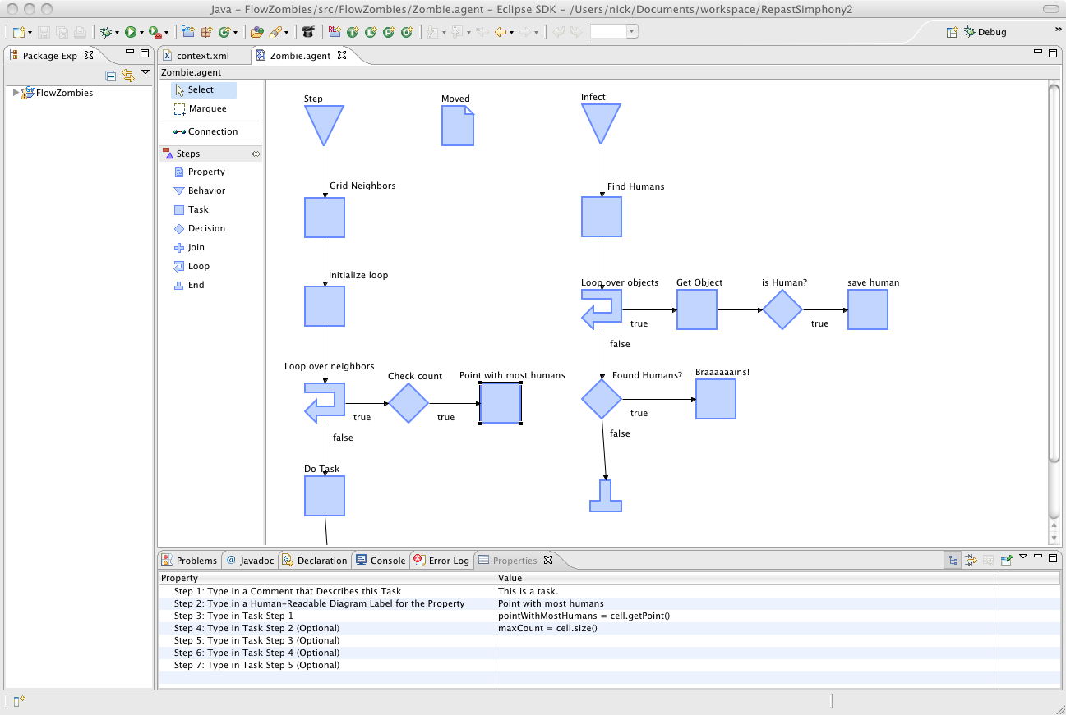
Graphical Environments
Entirely visual - no programming needed
Most useful for non-programmers
Examples
Agent Sheets
VisualBots
Repast Simphony
Modelling4All
Visual model development in Repast Simphony

Slide 7
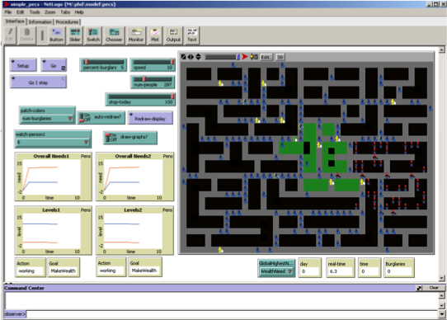
Somewhere in the middle
Some code writing, some visual development
More powerful than purely visual tools, but easier to use.
Save time having to learn to do simple tasks and concentrate on model behaviour
e.g. NetLogo
An example of a NetLogo model

Slide 8
Overview
An overview of tools for agent-based modelling
An introduction to NetLogo:
The Program itself
Turtles and Patches
Variables
Flow Control
How to write good code

Slide 9
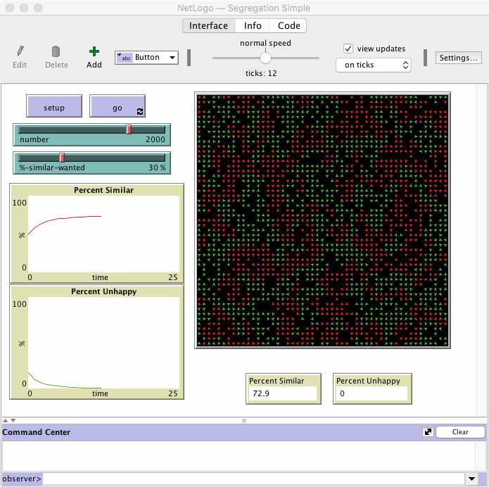
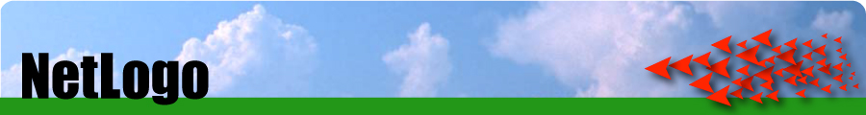
NetLogo
Based on Star Logo.
Popular teaching tool
Designed to be used by children
But also very powerful
Lots of serious research is done using NetLogo
The Schelling segregation model in NetLogo

Slide 10
NetLogo
Developed by The Centre for Connected Learning (CCL) and Computer-Based Modeling at Northwestern University
Free!
Uses Java in the background
Multi platform
Can be converted into applets or JavaScript (and embedded in websites)
Great for quickly putting a model together and thinking through ideas
Easy to build
Easy to interact with models
East to extract data and create plots
Excellent documentation: http://ccl.northwestern.edu/netlogo/docs/

Slide 11
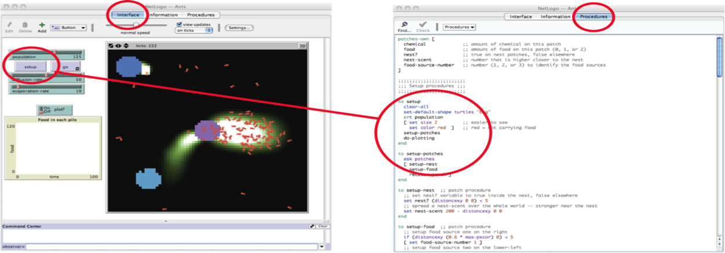
The NetLogo Program
NetLogo is has three parts:
Graphical part (Interface) with sliders, graphs, buttons and a map
Information (description, metadata, etc)
Scripting part (Procedures) which contains instructions (code)

Slide 12
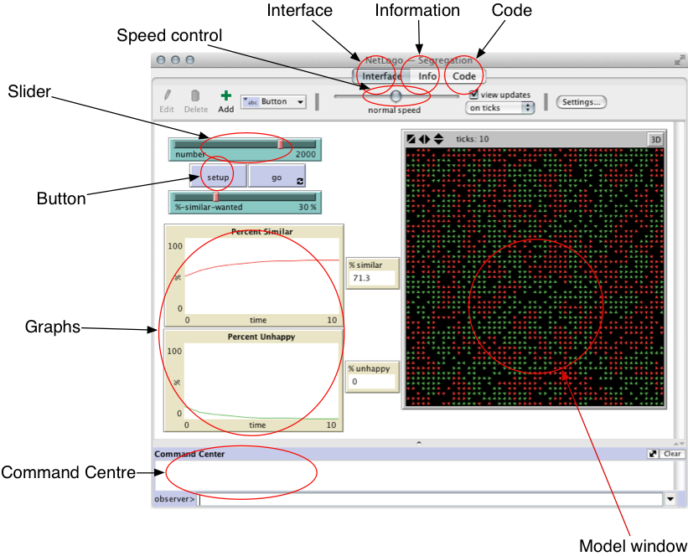
The NetLogo ‘Interface’ Tab

Slide 13
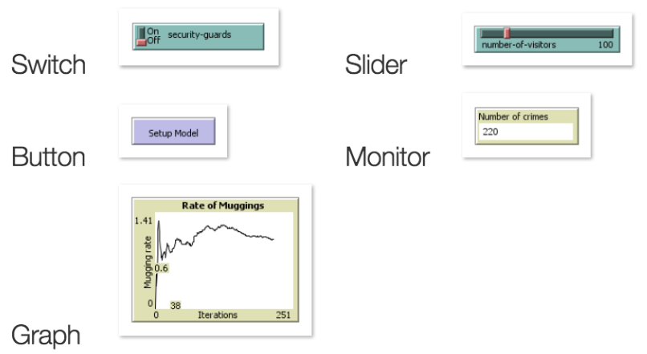
Components of the Interface

Slide 14
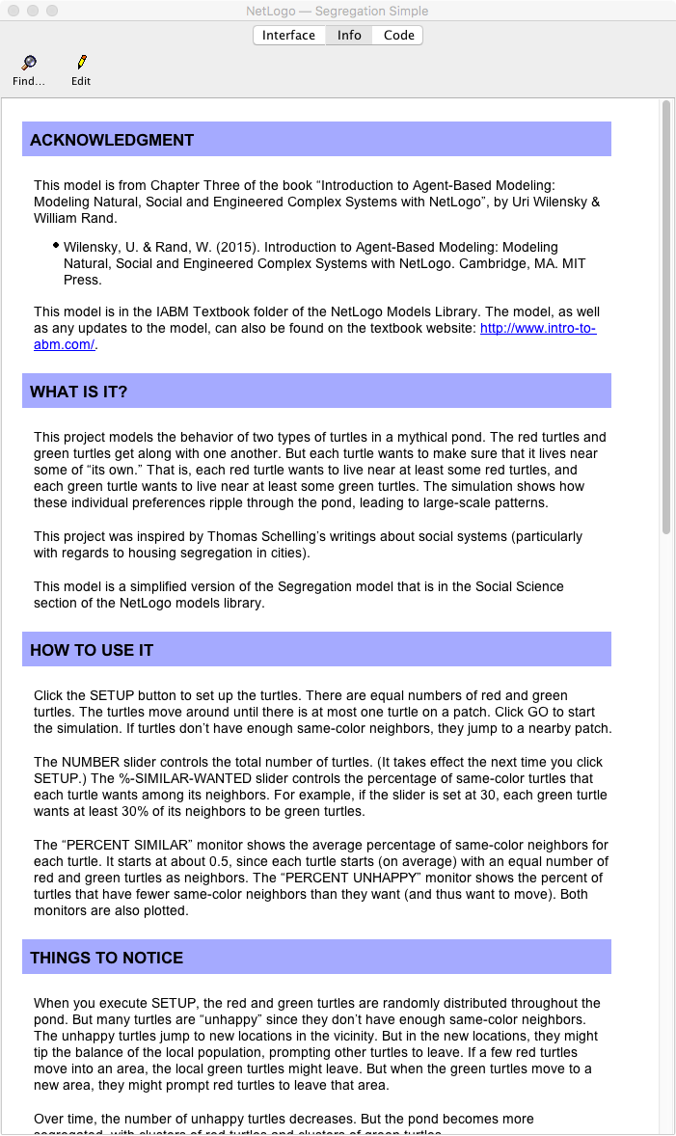
The NetLogo ‘Information’ Tab
Contains information about the model and instructions explaining how to run it
These are produced by model developers
Yu should do this when you write your own models

Slide 15
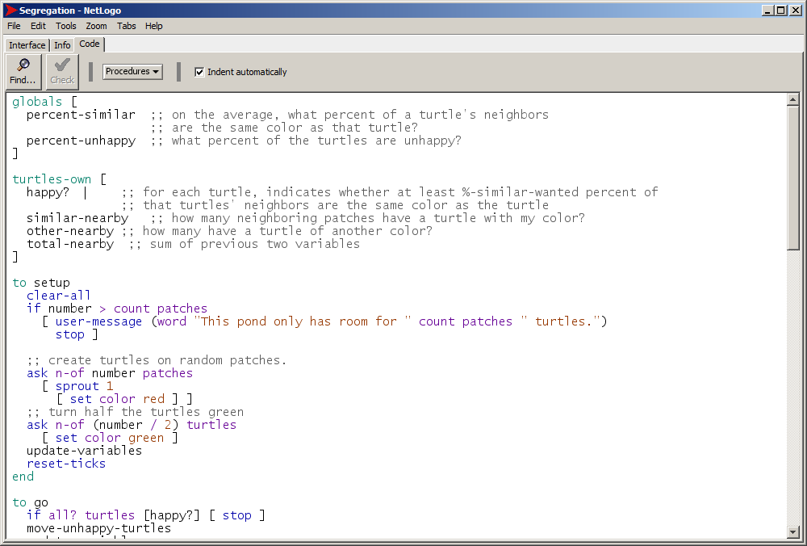
The NetLogo ‘Code’ tab
This is where you write the code
All agent rules, etc., go in here

Slide 16
NetLogo example 1 - Segregation
When you download NetLogo there are a number of examples
We will now experiment with Schelling’s famous segregation model
To see a list of the models that are available, open NetLogo and go to
File -> Models Library
The Segregation model is listed under
Social Science -> Segregation

Slide 17
NetLogo example 1 - Segregation
Once you have opened the Segregation model:
Click on the ‘Information’ tab (or ‘Info’ in some versions) and read about the model
Then return to the ‘Interface’ tab and experiment with the model by slowly increasing the peoples’ preference for living next to the same type (%-similar-wanted).
Try to answer these questions:
What happens to the spatial structure of the population as it increases?
What would you expect to see if %-similar-wanted was set to 100%? What actually happens?

Slide 18
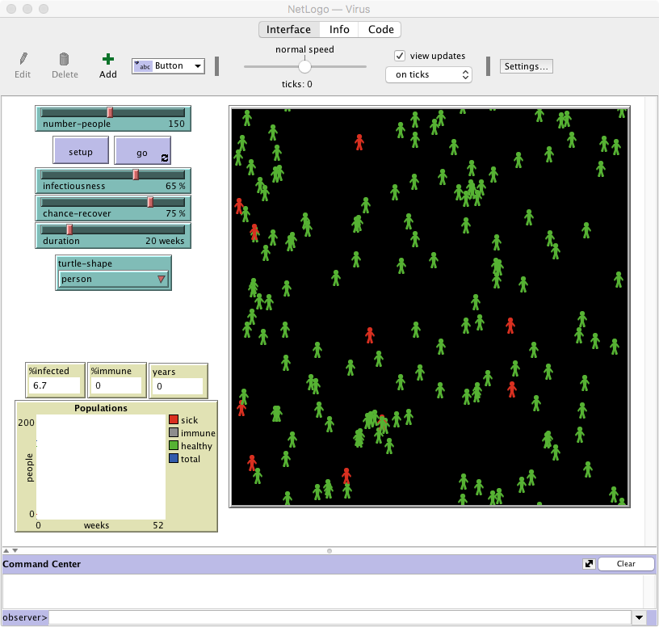
NetLogo example 2 - Virus
Now experiment with another model called Virus, which is in the Biology folder.
Again, start by reading the documentation in the Information tab.
Then experiment and answer the following:
What happens as the chance of recovering decreases? What happens when it gets to 0 (i.e. everyone who becomes infected dies)?
Does the same thing happen every time the model is run? If not, what might account for these differences?

Slide 19
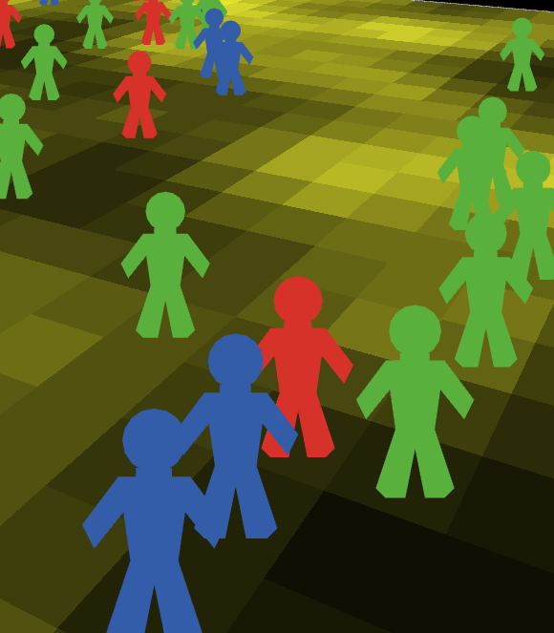
Model Concepts: Turtles, Patches and the Observer
There are two types of objects in NetLogo: turtles and patches.
Both are agents
They have rules that determine their behaviour
They can interact with other agents
Main differences:
Patches cannot move
You can create different types of 'turtle' (e.g. person, dog, cat, car, etc.)
Why turtles?
The 'Logo' language originally used to control robot turtles. It seems that the name 'turtle' has stuck..

Slide 20
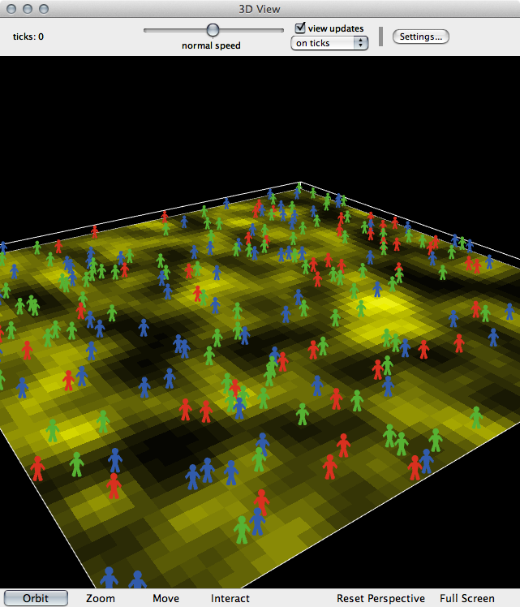
Model Concepts: Turtles, Patches and the Observer
Also important: the observer
The 'god' of a model
Overseas everything that happens, gives orders to turtles or patches, controls other things like data input/output, virtual time, etc.

Slide 21
Model Concepts: Variables
In programming, variables are a way of storing information. E.g.
my-name = ”Nick"
seconds-per-minute = 60
pi = 3.142
infected = True
Variables can belong to different objects in the model.
Different objects can have different variable values (e.g. my-name variable would be unique to each agent)
Examples:
Turtle variables: name, age, occupation, wealth, energy
Patch variables: height-above-sea, amount-of-grain, building-security, deprivation
Observer variables: total-wealth, weather, time-of-day, pi

Slide 22
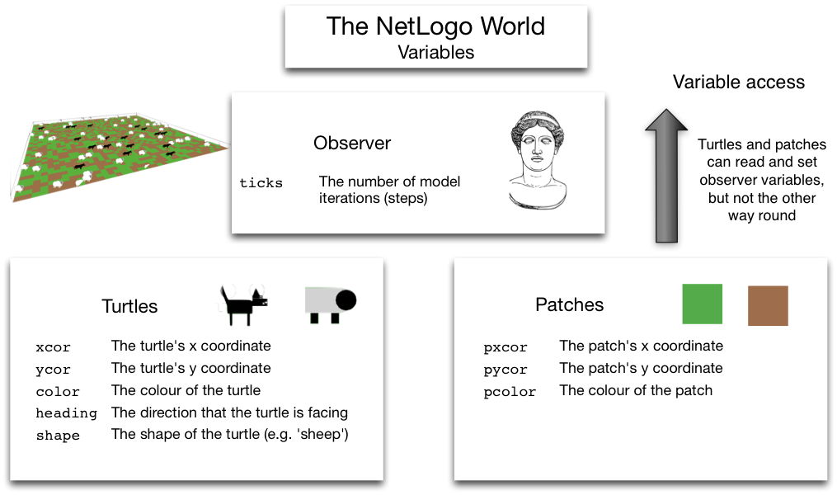
Built-In Variables
There are some variables that NetLogo uses by default

Slide 23
Model Concepts: Commands
Commands are the way of telling NetLogo what we want it to do.
Commands are very well documented
Some examples (these are explained properly in the book):
Command example | Description
show "Hello World" | Prints something to the screen
set my-age 13 | Sets the value of a variable
ask turtles [ ... ] | Ask the turtles to do something
ask turtles [ set color blue ] | Asks the turtles to turn blue

Slide 24
Model Concepts: Brackets
NetLogo uses both square [ ] and round ( ) brackets.
Round brackets are used to set the order of operations. E.g.:
2 + 3 × 4 = 14
(2 + 3) × 4 = 20
Square brackets are used to split up commands. E.g.:
ask turtles [ ... ]
the ask command expects to find some more commands inside the brackets.

Slide 25
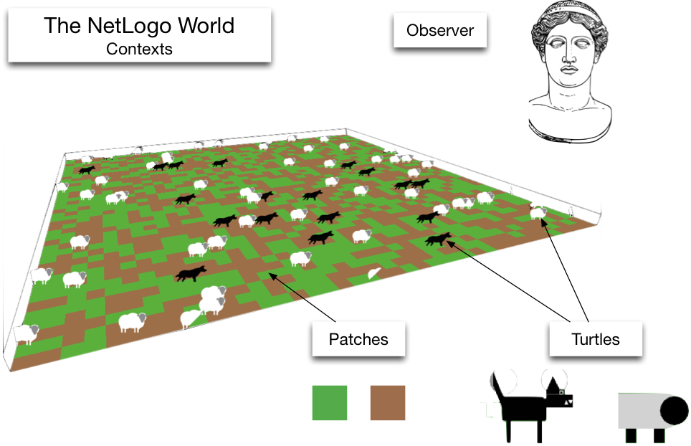
Model Concepts: Contexts
Contexts controls where commands are sent
There are three contexts:
Observer
Turtle
Patch
Lots of examples that help to understand these in the book (Chapter 4)

Slide 26
Model Concepts: Flow Control
Programs are recipes
And computers are really, really stupid cooks.
Programmers need to tell the computer exactly what to do, and in what order
Geek Joke:
Q: How do you keep a programmer in the shower forever?

Slide 27
Model Concepts: Flow Control
Programs are recipes
And computers are really, really stupid cooks.
Programmers need to tell the computer exactly what to do, and in what order
Geek Joke:
Q: How do you keep a programmer in the shower forever?
A: Give them a bottle of shampoo that says "lather, rinse, repeat".

Slide 28
Flow Control
Usually, NetLogo will run through your code, one line after the other
But! Sometimes there are two or more possibilities for what to do next
if statements are one example:
if ( age < 18 ) [ .. do something .. ] if ( age > 18 ) [ .. do something else .. ]

Slide 29
Flow Control Quiz
The code below has been taken from the rules that drive the behaviour of a virtual person (or 'agent’).
What will the person do when the age variable has the values of 10, 50, or 18?
Age | Actions
10 | ?
50 | ?
18 | ?
if ( age < 18 ) [ .. go to the cinema .. ] if ( age > 18 ) [ .. go to the pub .. ] .. go to my friend's house ..

Slide 30
Flow Control Quiz
The code below has been taken from the rules that drive the behaviour of a virtual person (or 'agent’).
What will the person do when the age variable has the values of 10, 50, or 18?
Age | Actions
10 | Go to the cinema and then to my friend’s house
50 | Go to the pub and then to my friend’s house
18 | Just go to my friend’s house (agents who are exactly 18 don’t fit either of the if statements).
if ( age < 18 ) [ .. go to the cinema .. ] if ( age > 18 ) [ .. go to the pub .. ] .. go to my friend's house ..

Slide 31
Overview
An overview of tools for agent-based modelling
An introduction to NetLogo:
The Program itself
Turtles and Patches
Variables
Flow Control
How to write good code

Slide 32
Finally: Writing Good Code
Computers don't care what code looks like
But there are good conventions that we can use to make our code easier to understand by humans
Indentation
New blocks of code should be indented (moved to the right)
E.g. code in the if statements on previous slide
White space
Different sections of code can be separated by lots of white space
Comments
Comments are special parts of code that NetLogo will ignore
Anything after a semi colon (;) is ignored
Use comments to explain what your computer code does

Slide 33
Writing Good Code: Indentation

Slide 34
Writing Good Code: Whitespace

Slide 35
Writing Good Code: Comments

Slide 36
Summary
This lecture has introduced the main concepts that underpin NetLogo and demonstrated how to run some models
Next: Work through Chapter 4 of the book to gain some experience in using NetLogo, and to see how to create your own model.

Slide 37
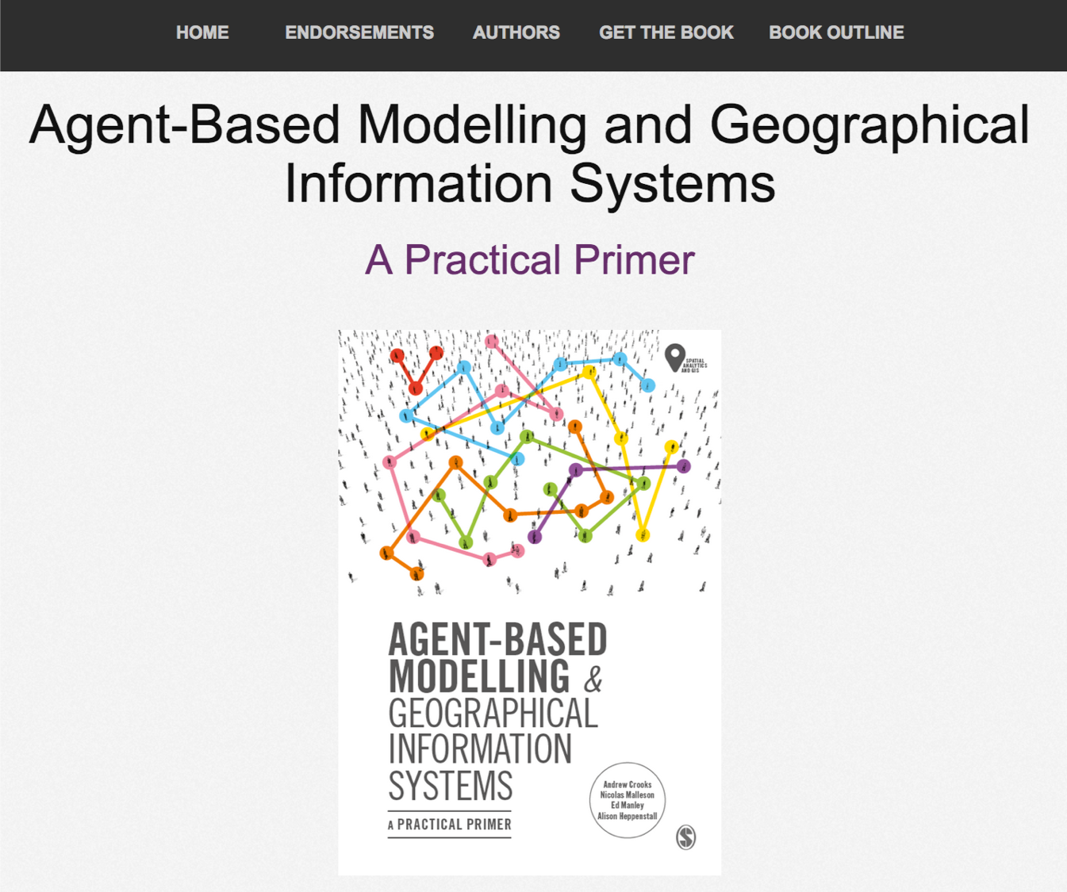
Online Resources
Visit: https://github.com/abmgis/abmgis/tree/master/Chapter04-NetLogo for a selection of models to highlight core concepts introduced in this chapter.

